Slide 1
Unit testing
Lecture - 12

Slide 2

Agenda:
Testing types
TDD. Red-Green-Refactor pattern
Testing frameworks
Sinon. Mock and stubs

Slide 3
Why unit testing
They guard against changes that break existing code “regressions”
They clarify what the code does both when used as intended and when faced with deviant conditions
They force loosely coupled design and good architecture
They force us to spend some time looking to the code and re-think it to understand better. To write less code
They increase our level of platform / framework understanding

Slide 4
Testing types
Unit testing
One class <UserManager> without dependencies (only mocks)
Integration Testing
How set of classes works together <UserService + UserStore + DB>
End to End
Open app in real browser and emulate user clicks, inputs, checks
API

Slide 5
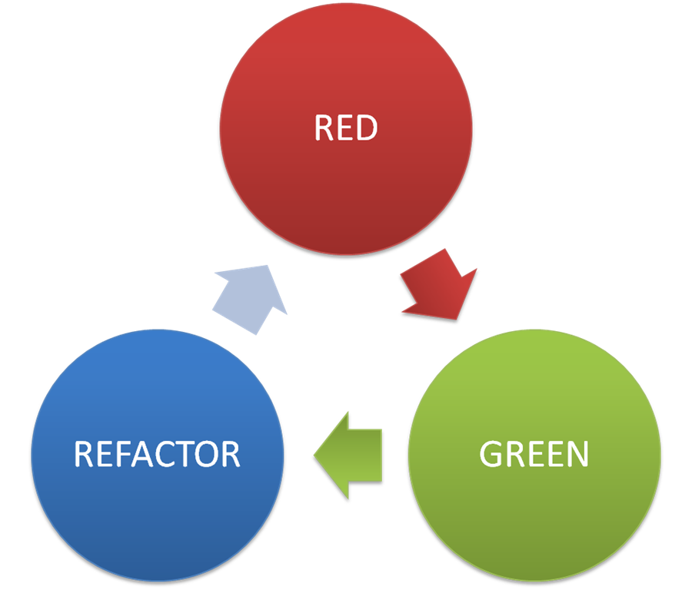
Test driven development
Write tests (see they FAIL)
Write the code (that makes tests PASS)
Refactor code (check tests PASS)

Slide 6
Add tests see them fail

Slide 7
Write the code makes test pass

Slide 8
Refactor check that tests pass

Slide 9

Mocha chai

Slide 10
AAA pattern

Slide 11
Describe + It

Slide 12
Grouping related specs

Slide 13
Matchers

Slide 14
To throw

Slide 15
Pre-conditions and after conditions

Slide 16
Disabling suites

Slide 17
Async support

Slide 18
BDD

Slide 19
User stories

Slide 20
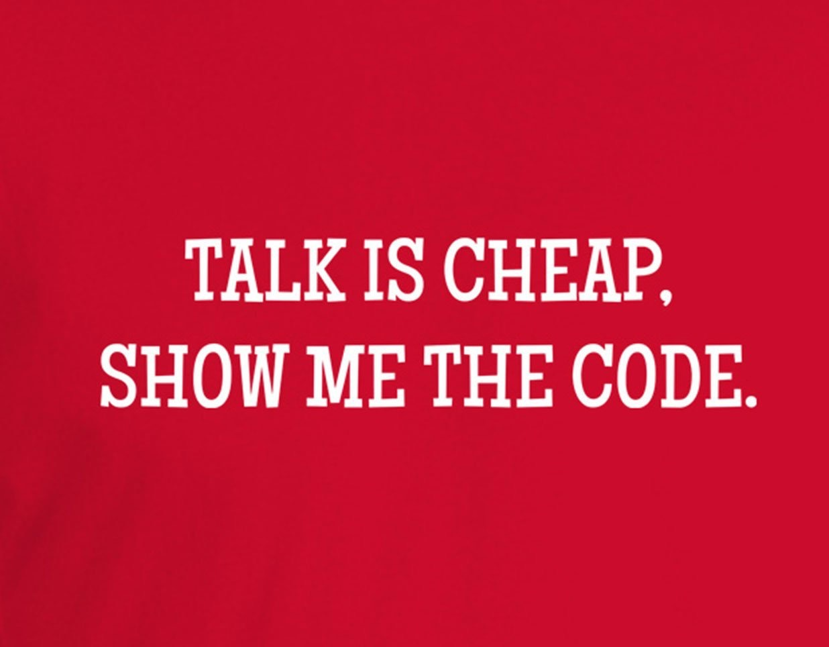

Semantic versioning

Slide 21

Thank you for your attention

